Slide 1

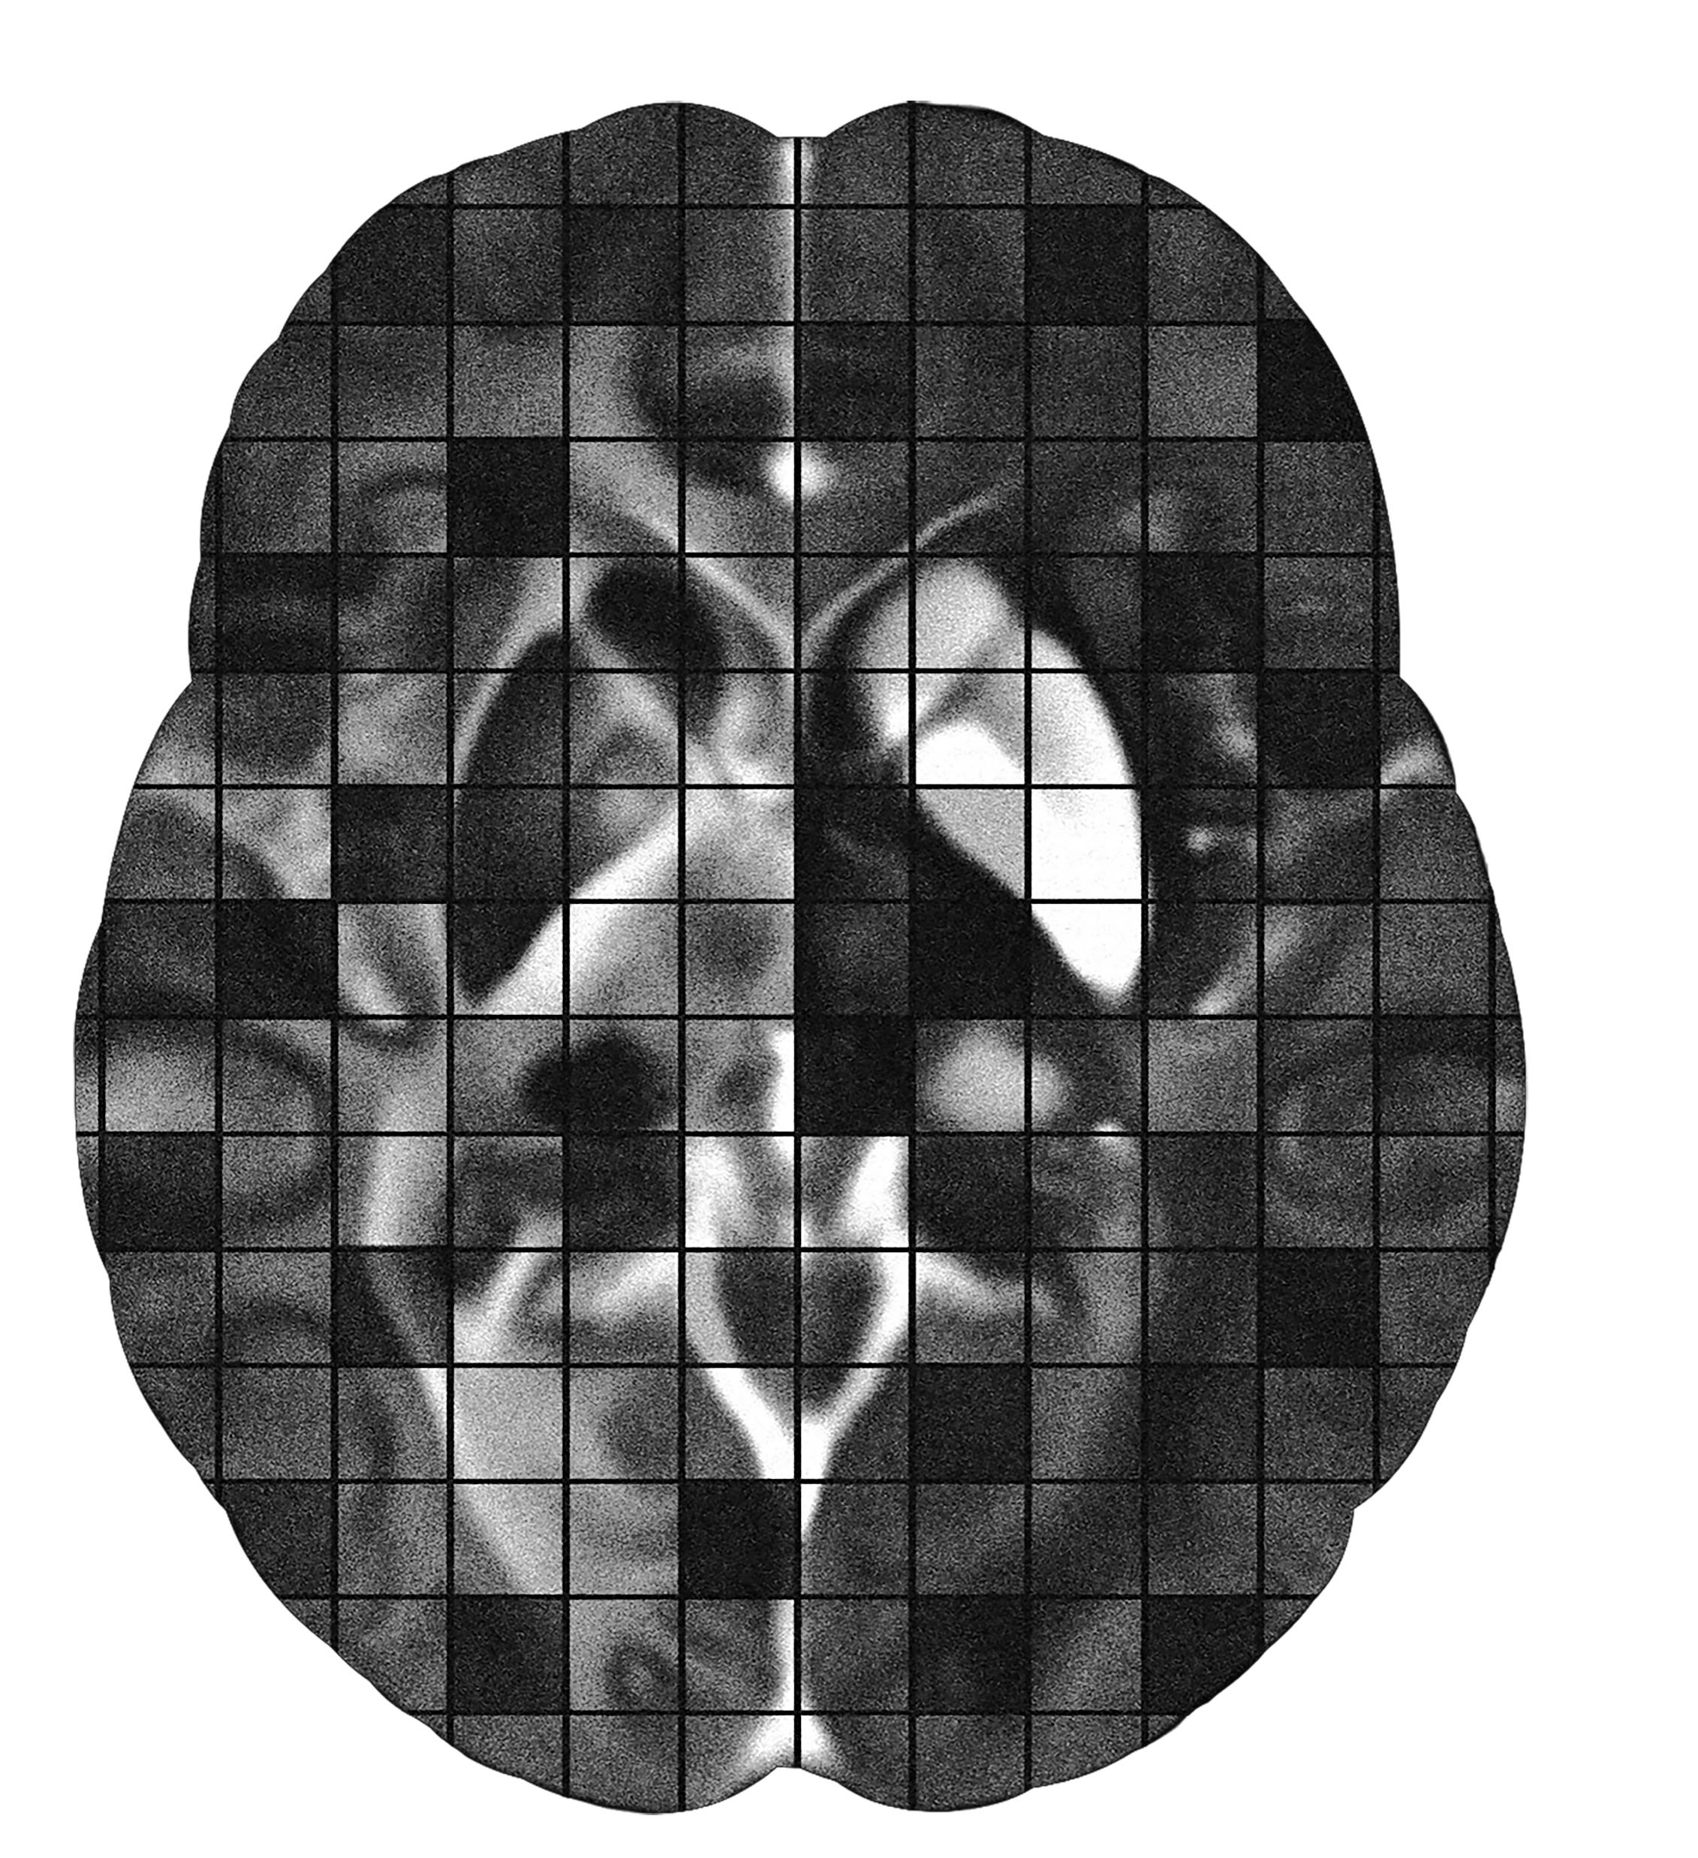
삼성 DS²과정 프로젝트
Image Restoration Challenge
Jongho Lee, Ph.D
Laboratory for Imaging Science and Technology
Department of Electrical and Computer Engineering
Seoul National University

Slide 2
Physics informed neural network

Slide 3
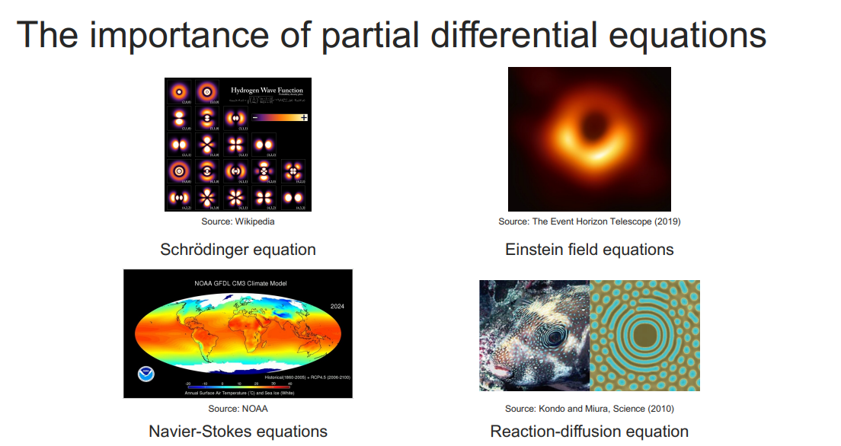

Slide 4
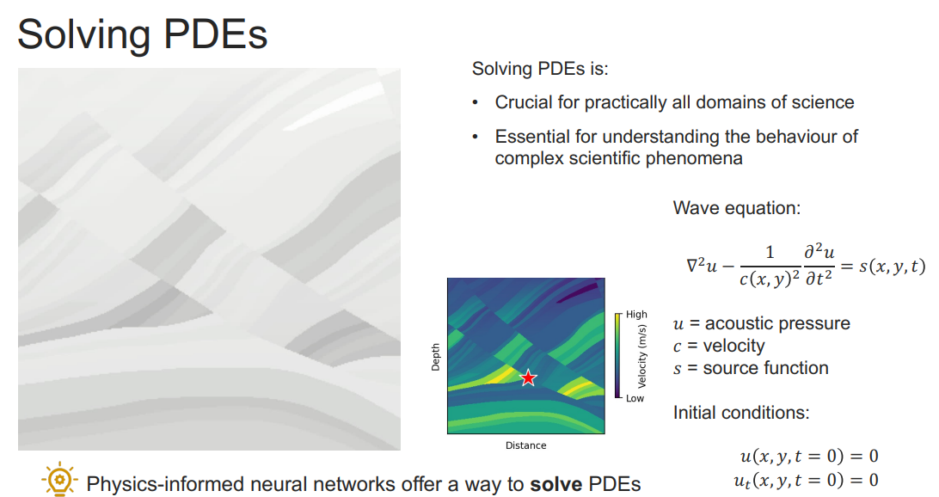

Slide 5
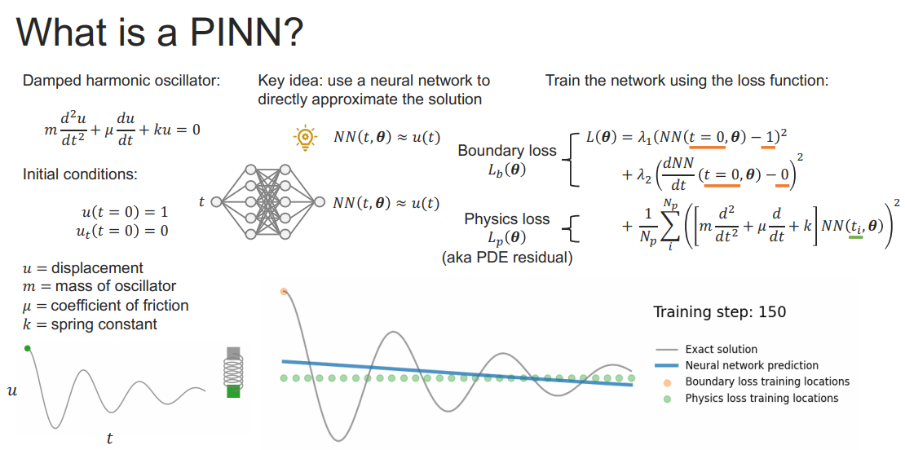

Slide 6
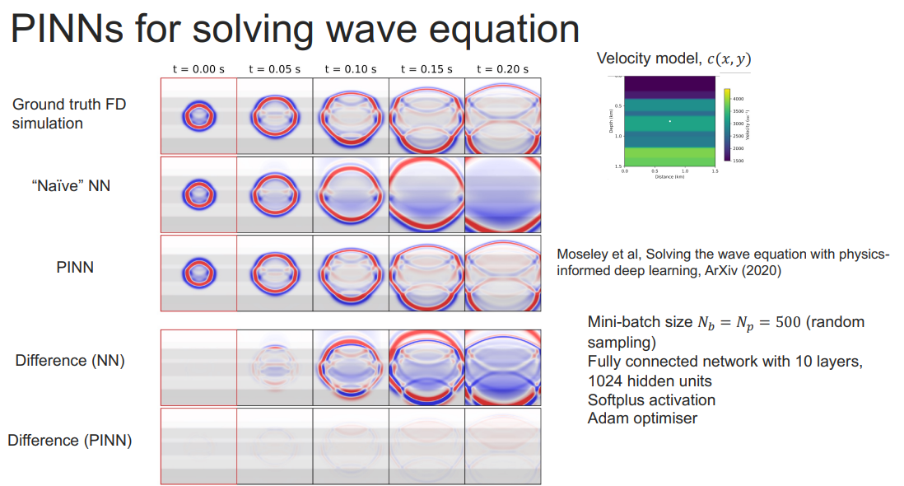

Slide 7
Why do we care?

Slide 8
Generalization issues in deep learning

Slide 9
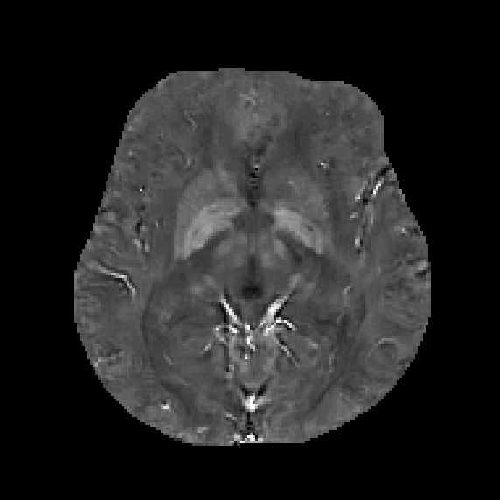
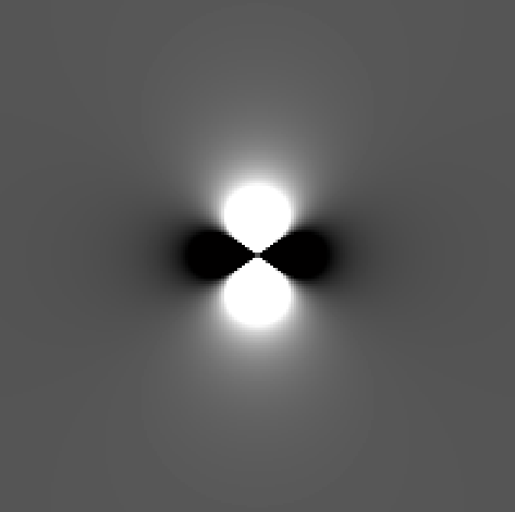
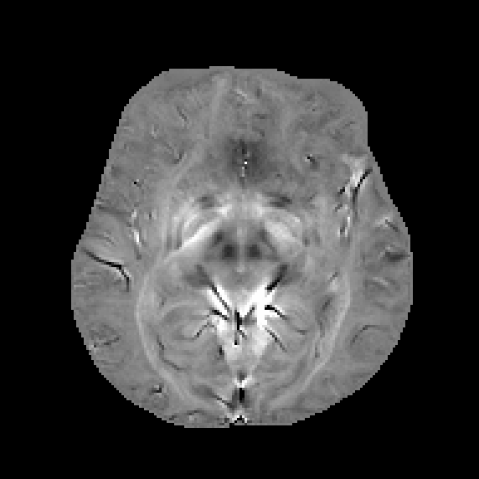
Dipole deconvolution
Convolution
Suscep distr
Dipole
Local field distr
$$⊗$$
=
Deconvolution
Local field map
Dipole
Suscep map
-1
$$⊗$$
=
Susceptibility map is generated from local field map by dipole deconvolution
Fourier transform suggests dipole deconvolution requires division by zeros

Slide 10
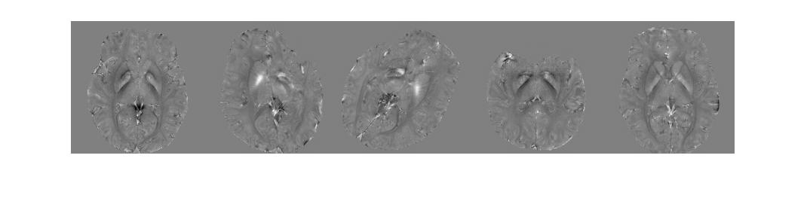
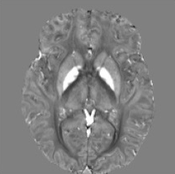
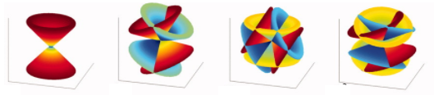
Dipole deconvolution
Multiple head orientation data
Remove zeros using three or more orientation data (COSMOS)
Tian Liu, MRM 2009
Sam Wharton, MRM 2010
Gold standard
Not practical
Single head orientation data
k-space threshold (TKD), regularization using magnitude edge information (MEDI) and others (iLSQR, HEIDI, ….)
Ludovic de Rochefort MRM 2008
Karin Shmueli, MRM 2009
Tian Liu, MRM 2011
Christian Langkammer, NeuroImage 2012
Wei Liu, NeuroImage 2015
Practical
Contain errors

Slide 11
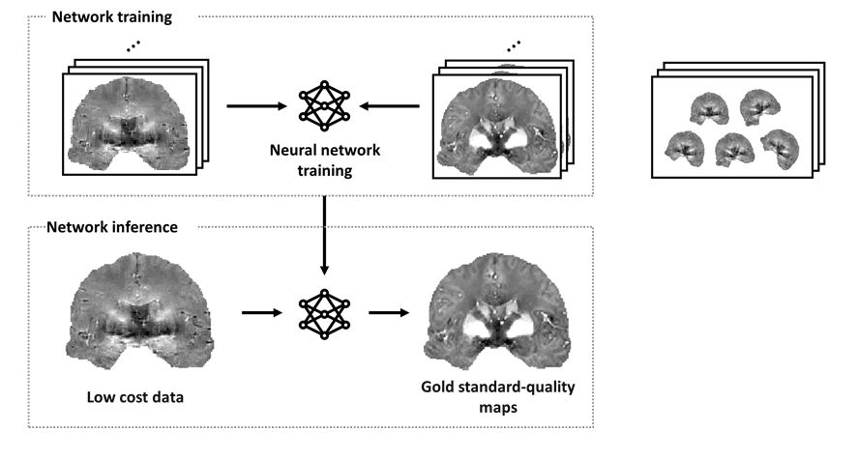
Dipole deconvolution using deep learning
Neural network shown success in inverse problem when expensive gold standard label is available e.g., parallel imaging with full sample data, low dose CT with full dose data
In QSM: for training, expensive COSMOS as label paired with single orientation local field as input
for inference, single orientation local field as input, generating COSMOS-quality QSM map
McCann, IEEE SPM 2017
Wang, Nature MI 2020
high cost data
QSMnet Yoon, NeuroImage 2018
DeepQSM Bollmann, NeuroImage 2019

Slide 12
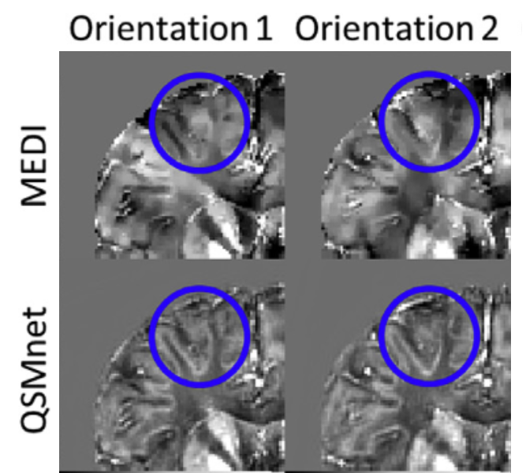
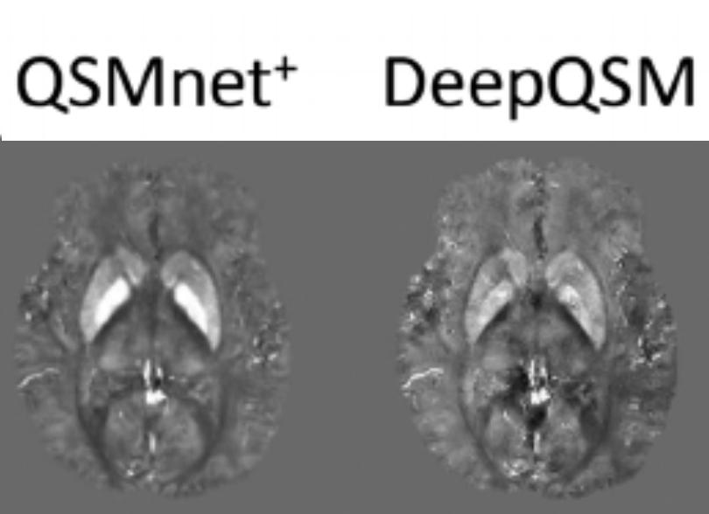
Dipole deconvolution using deep learning
3D U-net
Streaking free maps
TKD
MEDI
QSMnet
COSMOS
Computational efficiency (few secs)
COSMOS-trained or simulation-trained
Jung, NMR BioMed 2020
Yoon, NeuroImage 2018

Slide 13
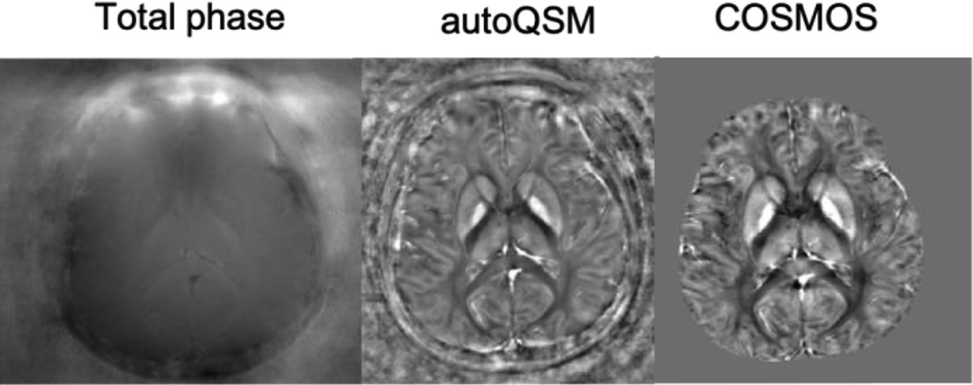
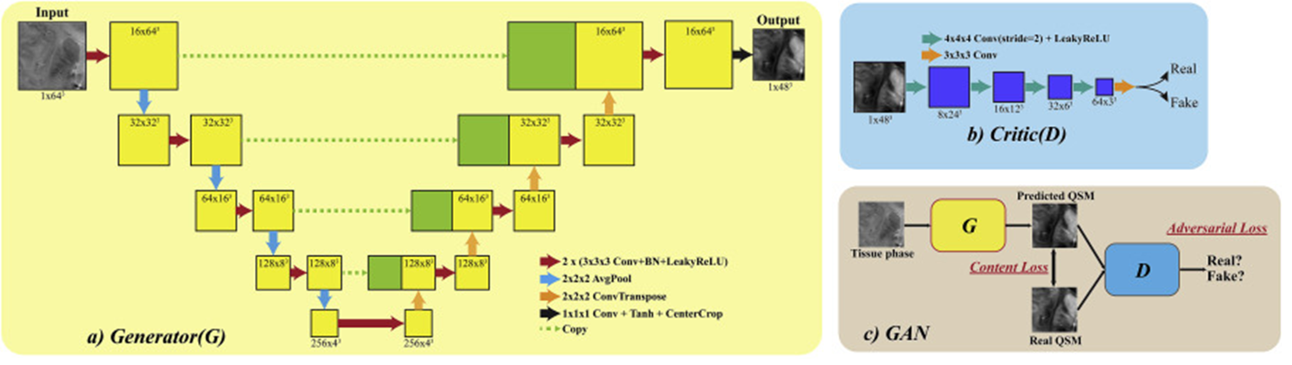
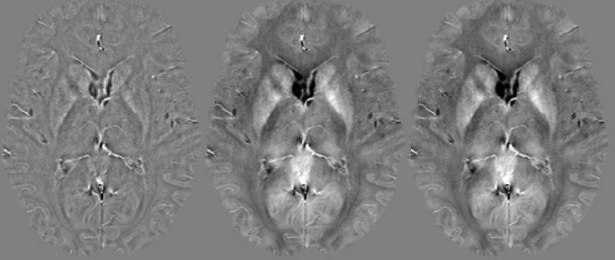
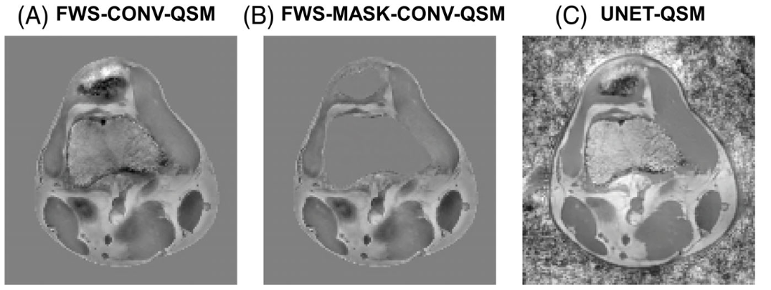
Dipole deconvolution using deep learning
AutoQSM: No need for background removal
or brain mask
QSMGAN: GAN improves quality
Wei, NeuroImage 2019
Chen, NeuroImage 2020
Recovering SWI-filtered phase data
QSM outside of brain with fat
Hanspach, MRM2022
Kames, MRM 2022
SWI-filtered phase Recovered Original

Slide 14
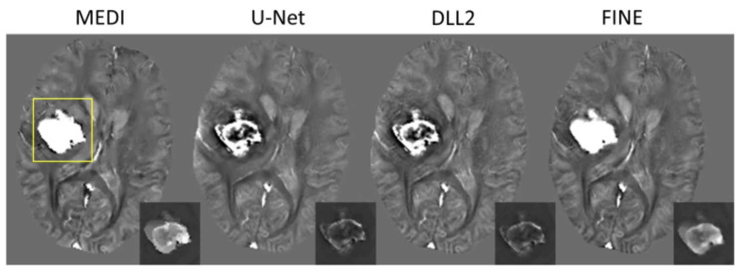
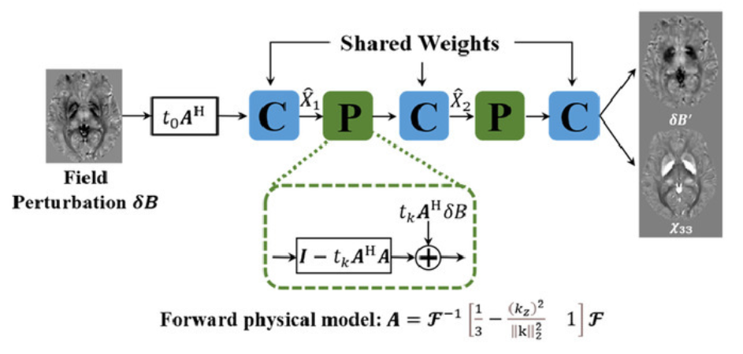
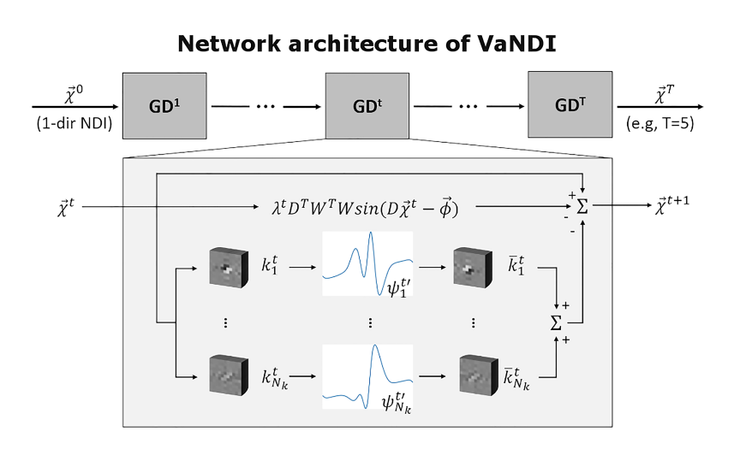
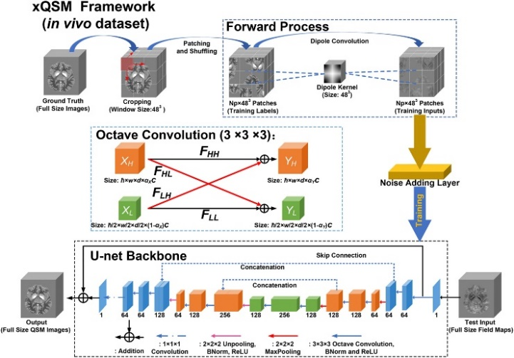
Dipole deconvolution using deep learning
FINE: Self transfer learning with physical model loss
MoDL-QSM: Physics model enforced with
network as regularizer
Generalization to untrained input
Zhang, Neuroimage 2020
Feng, Neuroimage 2021
xQSM: Octave conv and noise-regularization
Generalization for resolution
VaNDI: Combine nonlinear dipole inversion
with variational network
Gao, NMR Biomed 2021
Polak,
NMR Biomed
2020

Slide 15
Issues with deep learning dipole deconvolution
Issues of “generalization”
Issues of “performance comparison”
Issues of “performance”

Slide 16
Issues with deep learning dipole deconvolution
Issues of “generalization”
Issues of “performance comparison”
Issues of “performance”

Slide 17
Generalization: Susceptibility range
Training data distribution of QSMnet
Susceptibility value in lesion
Number of voxels
QSMnet (ppm)
Hemorrhage
• QSMnet
• QSMnet⁺
Susceptibility value (ppm)
Conventional QSM (ppm)
Jung, NeuroImage 2020
QSMnet was trained with limited susceptibility range (-0.4 to 0.6 ppm)
Hemorrhage with high susceptibility (>1 ppm) was underestimated in QSMnet
Augmentation using simulated data improves hemorrhage estimation in QSMnet+

Slide 18
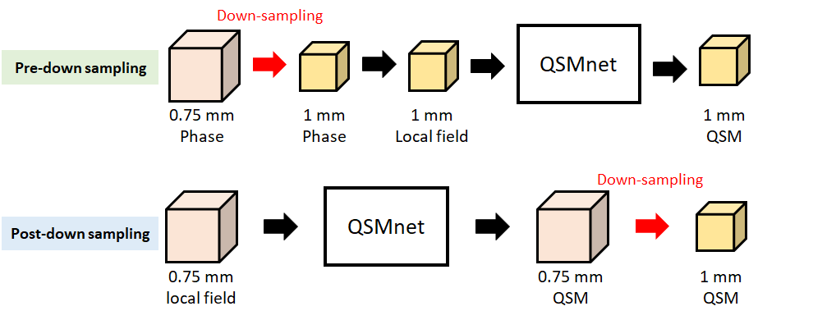
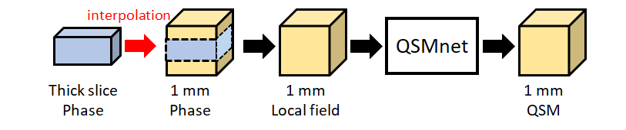
Generalization: Resolution
Jung, NMR BioMed 2020
Lower resolution
Higher resolution

Slide 19
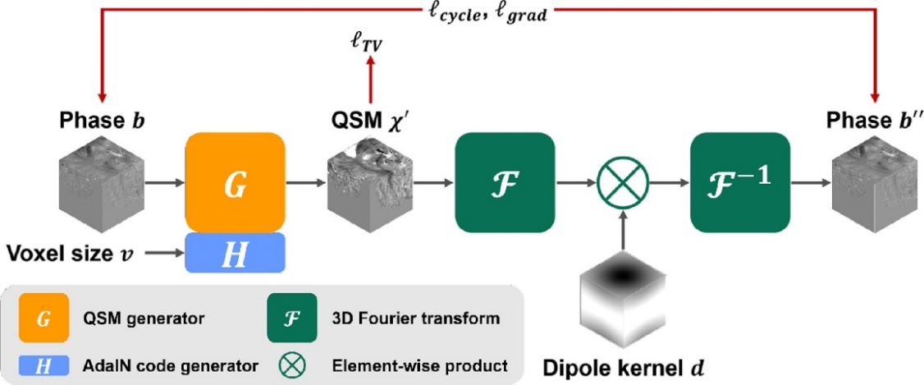
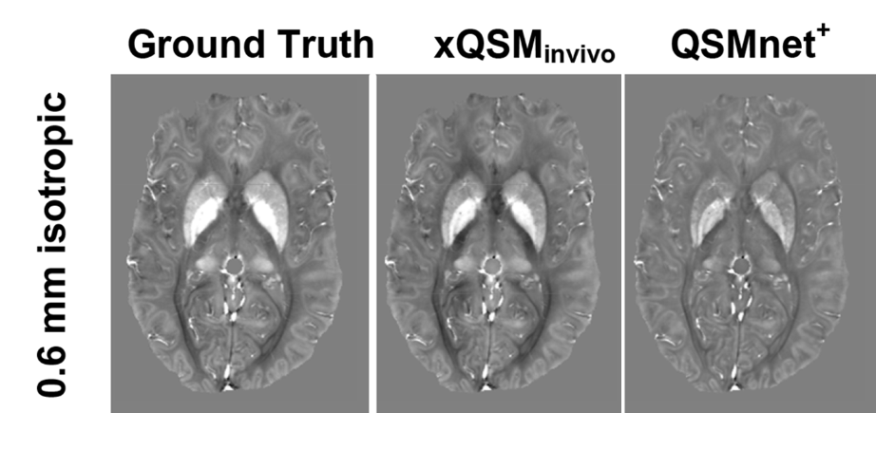
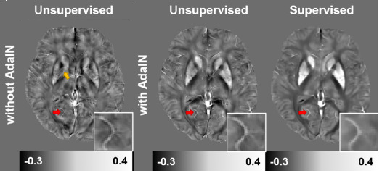
Generalization: Resolution
Gao, NMR Biomed 2021
Oh, Med Img Anal 2022
Unsuprevised learning with adaptive instance normalization

Slide 20
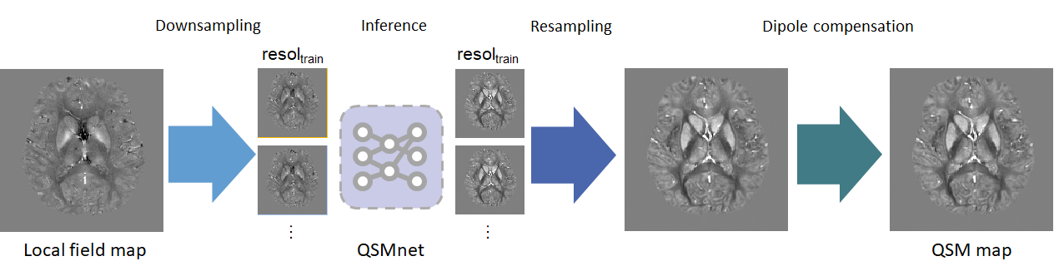
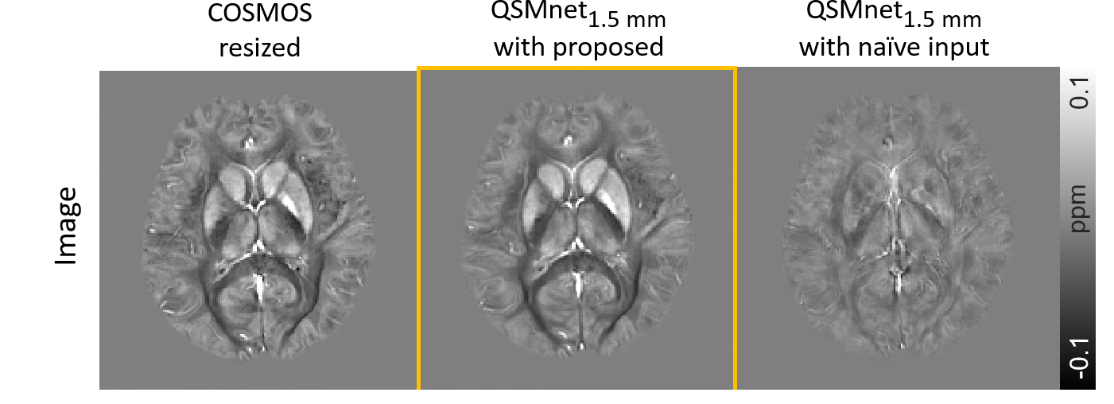

Generalization: Resolution
Sooyeon Ji
QSM workshop 2022
1 x 1 x 3 mm³ data inference for network trained using 1.5 mm iso

Slide 21
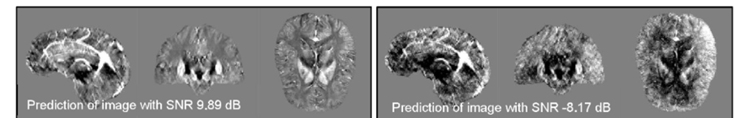
Generalization
Performance of deep learning QSM changes if test data has different characteristics from training data
Høy, ISMRM2019
Jung, NMR BioMed 2020
Notes:
Then, the linearity was improved in the new version of QSMnet, named as QSMnet+
This work was presented on last Monday with the number of abstract 317.

Slide 22
Generalization: Solutions using network architectures
FINE: Self transfer learning with physical model loss
MoDL-QSM: Physics model enforced with
network as regularizer
Generalization to untrained input
Zhang, Neuroimage 2020
Feng, Neuroimage 2021
VaNDI: Combine nonlinear dipole inversion with
variational network
Polak, NMR Biomed 2020
Networks need to be explored for generalization capability

Slide 23
Issues with deep learning dipole deconvolution
Issues of “generalization”
Issues of “performance comparison”
Issues of “performance”

Slide 24
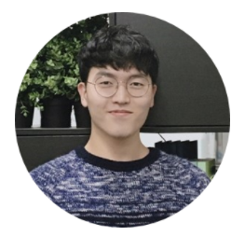
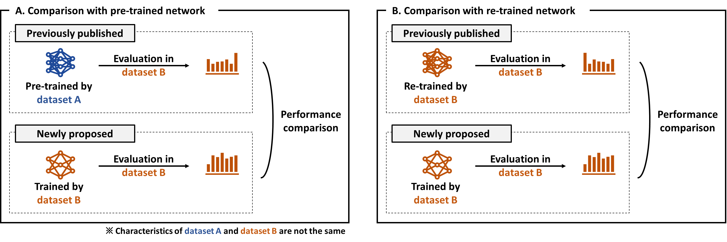
Performance comparison
No large size "public" dataset available for QSM
Comparison via "private" data of different characteristics (resolution, background removal ...)
Chungseok Oh
Comparison with pre-trained net not fair due to data characteristic difference affecting performance
Comparison with re-trained net not fair because retrain net is no longer the same as original net
Notes:
First, as we explained previous slide,
The training data of QSMnet consists of healthy subjects.
The training data distribution of QSMnet is plotted as shown here.
The x-axis is the susceptibility value of the voxel in training images, and y-axis is the number of voxels.
Since the network never observed the large susceptibility values such as hemorrhage lesions, or calcification during training stage,
we don’t know the network can perform properly in this range.

Slide 25
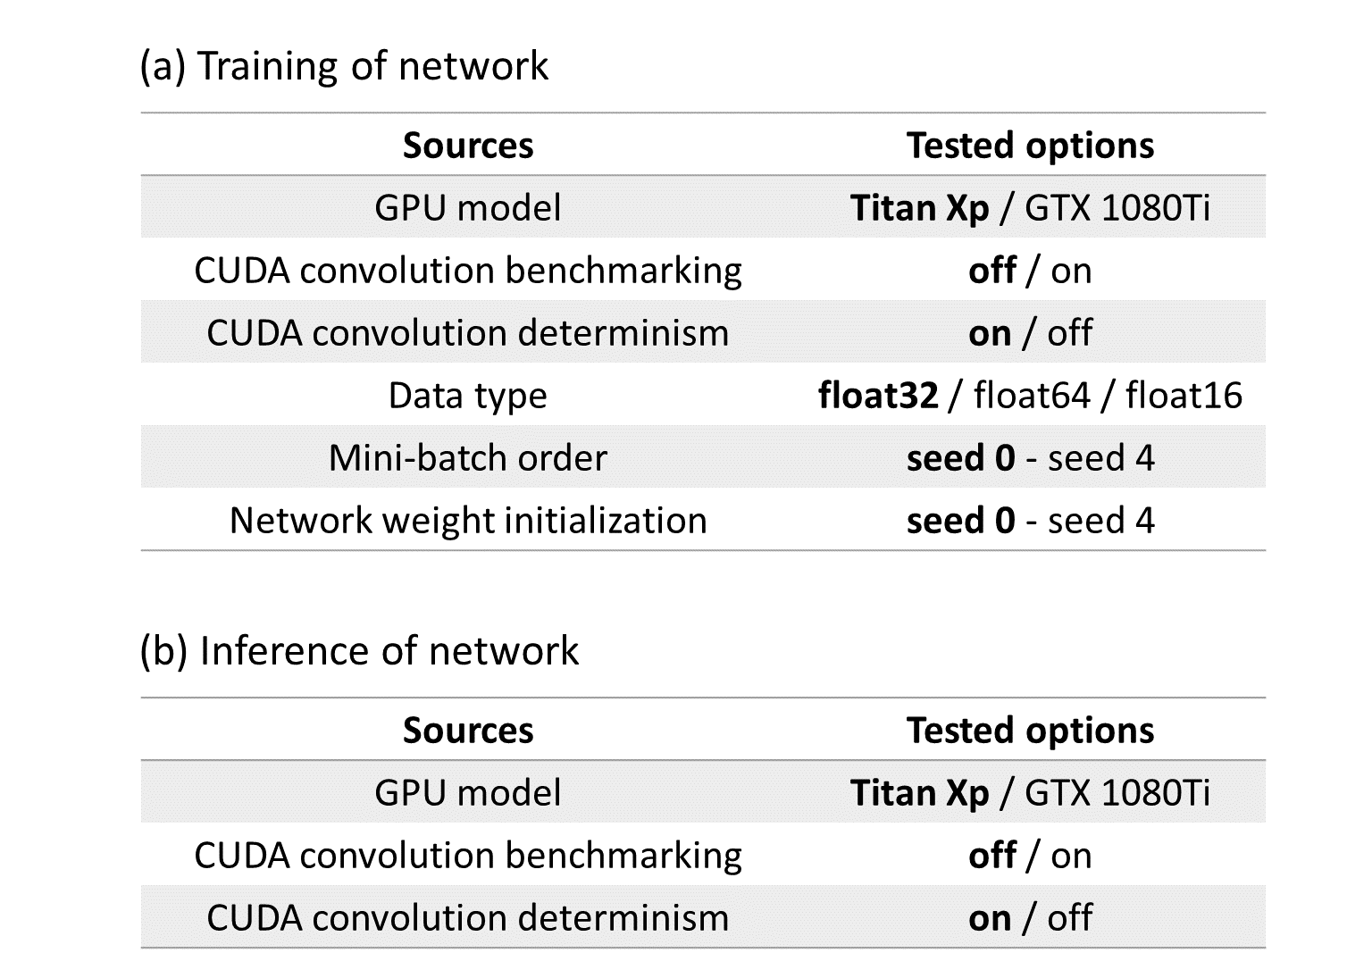
Performance comparison - reproducibility
Deep neural network has shown limited reproducibility
Renard, Sci Rep 2020 Alahmari, IEEE Acess 2020
QSMnet and variational network
Metrics: SSIM, RSME
For training, CUDA convolution bench marking and determinism, mini-batch order, and network weight initiation affect results
For inference, mostly reproduciblity
Oh, ISMRM 2022
For fair comparison, use of public dataset and sharing pretrained network is recommended
Notes:
First, as we explained previous slide,
The training data of QSMnet consists of healthy subjects.
The training data distribution of QSMnet is plotted as shown here.
The x-axis is the susceptibility value of the voxel in training images, and y-axis is the number of voxels.
Since the network never observed the large susceptibility values such as hemorrhage lesions, or calcification during training stage,
we don’t know the network can perform properly in this range.

Slide 26
Issues with deep learning dipole deconvolution
Issues of “generalization”
Issues of “performance comparison”
Issues of “performance”

Slide 27
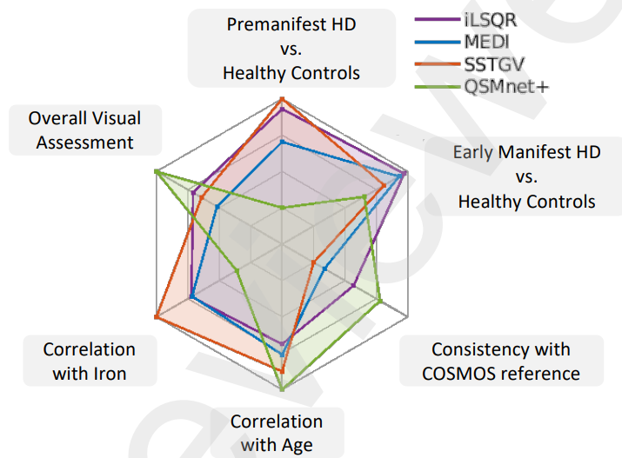
Performance
Deep learning shown high quality results but conventional recon outperformed in challenge 2.0
QSM Challenge, MRM 2021
Yao, NI clinical available online
Meaning of better performance?
Still problem of generalization? (7T? unbalanced training for high iron concentration?)
Can we design network for improved performance for deep gray matter iron quantification?
Redefine performance matrix (not only SSIM but "functional" performance)

Slide 28
Generalization vs. Harmonization

Slide 29
Generalization vs. Harmonization
Generalization:
Develop neural network that can process various conditions of input
(e.g., different vendor images)
Harmonization:
Process input image to have similar characteristics to training data
Siemens
Philips
How:
Data augmentation, network architecture
How:
Preprocessing using neural network
Cons and pros:
Need more data or new design
May generalize for unknown domain
Takes longer time for training
Cons and pros:
Need to design new network (require data)
Takes longer time for inference
*No need to worry if network is used for the same characteristic dataset as train data

Slide 30

Siemens
Philips

Slide 31
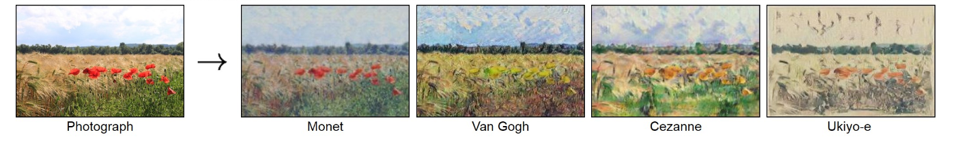
Image harmonization: Style transfer
CycleGAN
$$x$$
$$G(x)$$
$$y$$
Siemens
(unpaired)
Philips style image
Philips
$$G$$
$$D$$
fake
$$D$$
real
If paired data set available: Supervised learning
Only unpaired data available: Style transfer via cycleGAN
Combine both for limited paired data
Philips style
or not
Zhu, ICCV 2017
CycleGan with paired data
$$L_{L1}$$
Siemens
(pair A)
Philips style image
$$L_{GAN}(G, D)$$
Philips
(pair A)
$$G$$
$$G(x)$$
$$D$$
fake
$$y$$
real
Siemens
(pair A)
Siemens
(pair A)
Philips style
or not
$$x$$
$$x$$
$$G^{∗}=\arg{\min_{G}{\max_{D}{L_{GAN}\left(G, D\right)+λL_{L1}(G)}}}$$
0.43 x 0.43 x 1.5 mm³
Isola, CVPR 2017

Slide 32
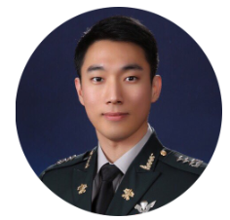
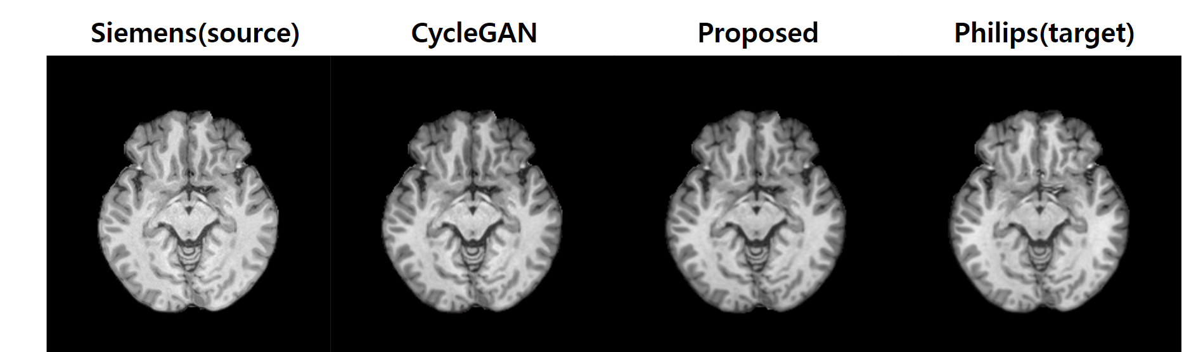
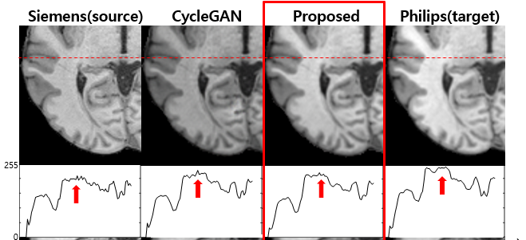
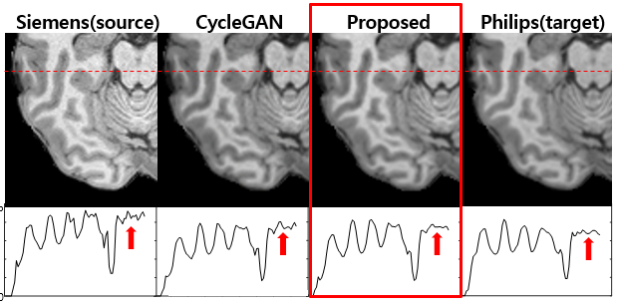
Image harmonization: Style transfer
Joonhyeok Yoon
ISMRM 2022
0.43 x 0.43 x 1.5 mm³

